Slide 1
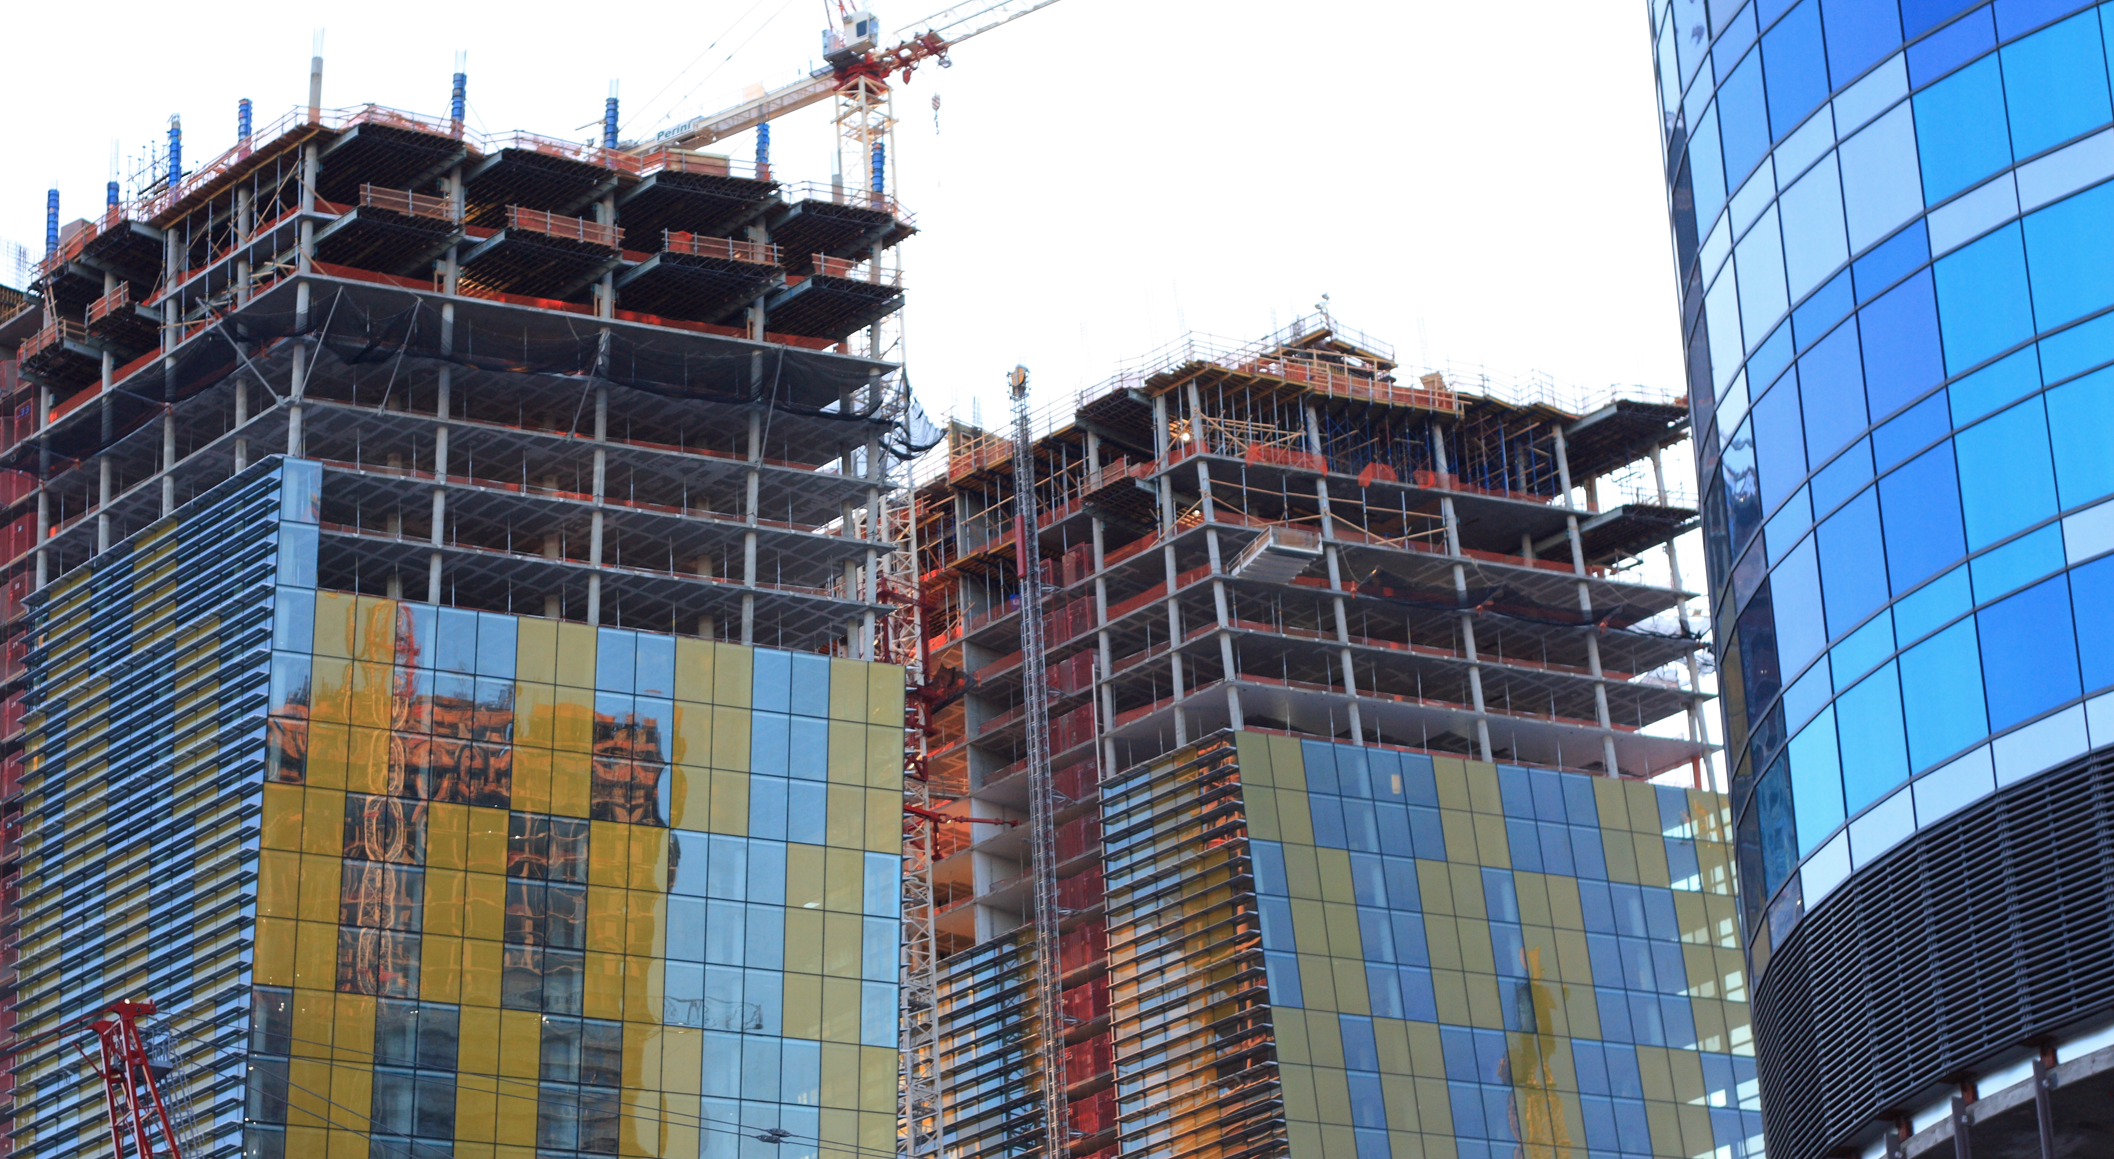
Class 3:
Elliptic Curve Cryptography
y² = x³ + 7
Project 1 will be posted by midnight tonight, and is due on January 30.
Cryptocurrency Café
cs4501 Spring 2015
David Evans
University of Virginia

Slide 2
Plan for Today
Bitcoin Wallets and Passwords
Asymmetric Cryptography Recap:
Transferring a Coin
Crash Course in Number Theory
Elliptic Curve Cryptography

Slide 3
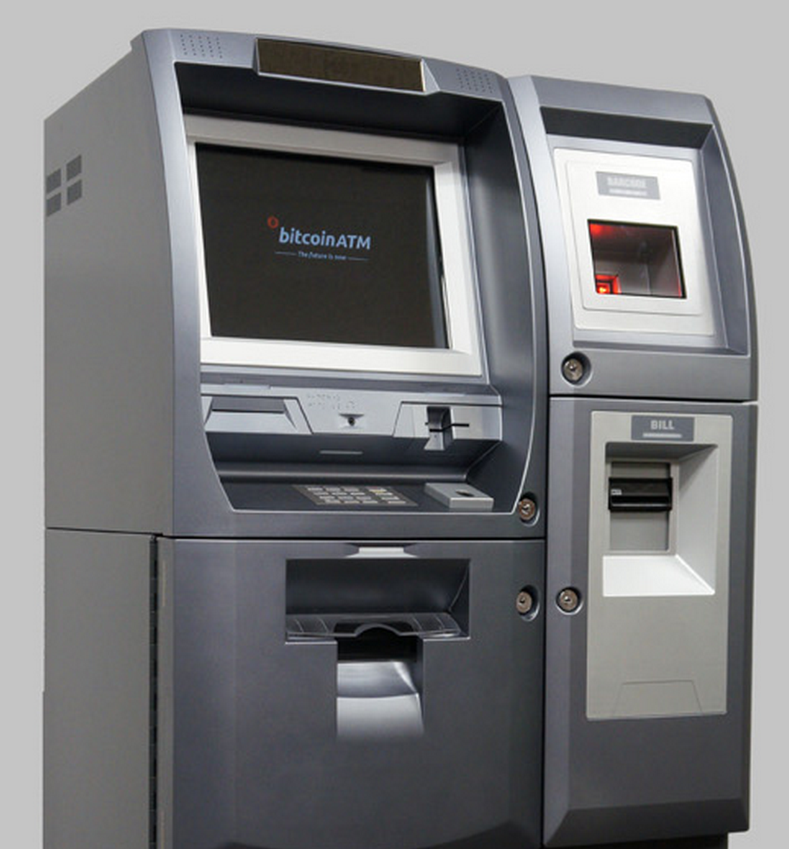
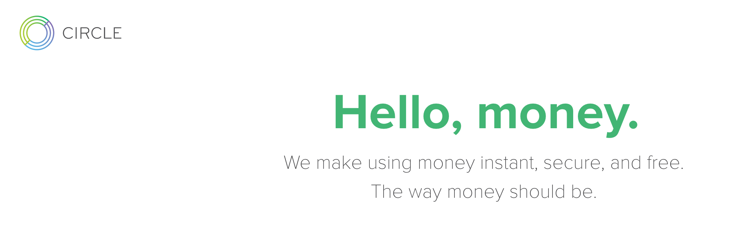

Buying Bitcoin

Slide 4
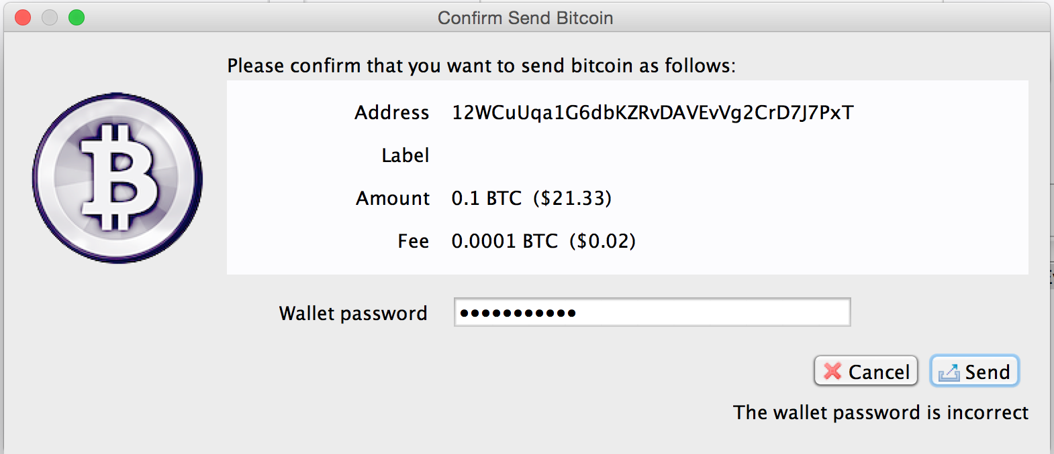

Slide 5
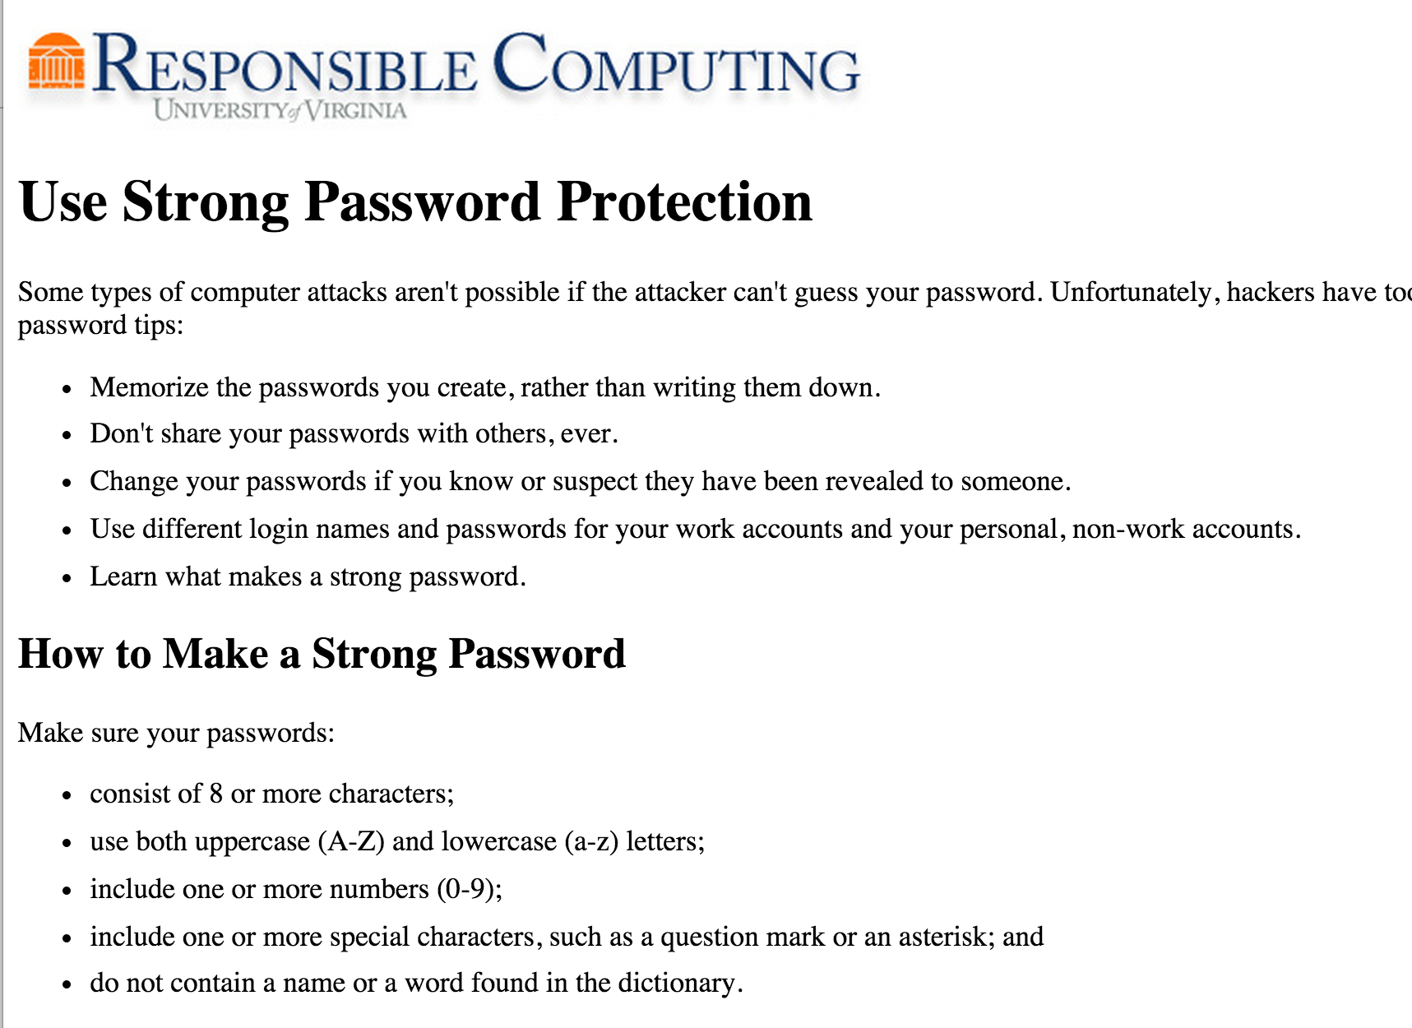

Slide 6
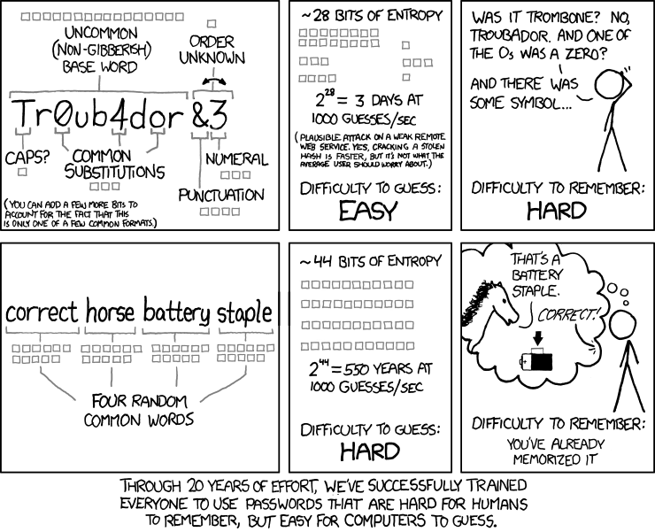

Slide 7
My Advice
Don’t waste brainpower/space on passwords that don’t matter
“silly” is a fine password for most things than need one
Don’t follow any widely-available advice
password cracker authors can read too!
Humans cannot generate randomness and neither can you
Generate a random password
Share your password
(but only with people with whom you are willing to raise children)
Write down your important passwords
Store them somewhere safe, and write down in a way that someone who steals it wouldn’t be able to use.

Slide 8
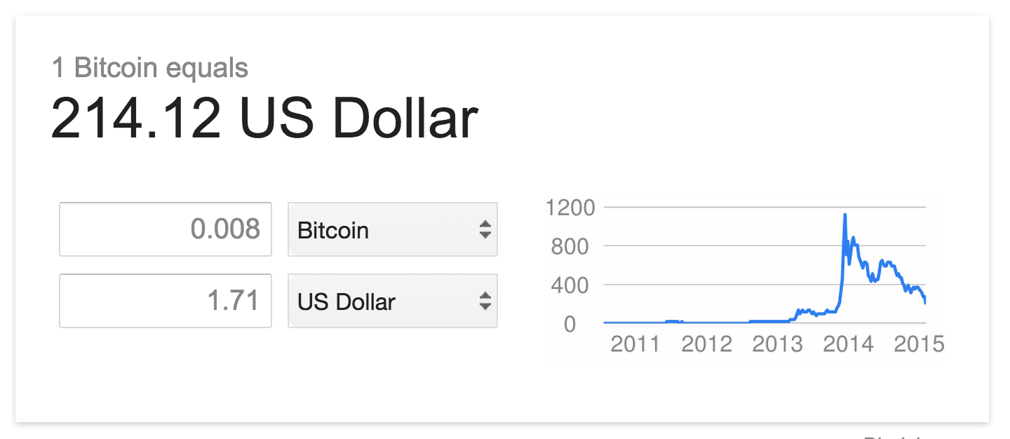
Using Bitcoin in This Class
It is “real” money: try not lose (all of) it. (But you can do everything in this class with very small amounts.)
If you do, I’ll send you more (so long as you learned something from the loss). Everyone gets one embarrassment-free transfer.

Slide 9
Using Asymmetric Crypto: Signatures
Anyone
Bob
Get KU_{B} from trusted provider
Generates key pair: KU_{B}, KR_{B}
Publishes KU_{B}
Verified
Message
E
Signed Message
D
Message
Insecure Channel
KU_{B}
KR_{B}

Slide 10

Transferring a Coin
Alice signs m₁ = { “I give coin x = KU_{A}, t to address KU_{B}.”} with KR_{A}.
How does Bob transfer x to Colleen (KU_{C})?

Slide 11
Transferring a Coin
Alice signs m₁ = { “I give coin x = KU_{A}, t to address KU_{B}.”} with KR_{A}.
Bob signs m₂ = { “I give coin x = KU_{A}, t, given to me by m₁to address KU_{C}.”} with KR_{B}.

Slide 12
Transferring a Coin
Alice signs m₁ = { “I give coin x = KU_{A}, t to address KU_{B}.”} with KR_{A}.
Bob signs m₂ = { “I give coin x = KU_{A}, t, given to me by m₁to address KU_{C}.”} with KR_{B}.
Colleen signs m₂ = { “I give coin x = KU_{A}, t, given to me by m₂to address KU_{D}.”} with KR_{C}.
…
This does not prevent double spending! (Next week)

Slide 13
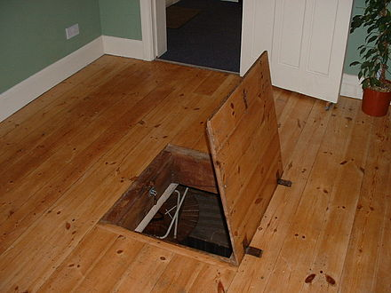
Asymmetry Required
Need a function f that is:
Easy to compute:
given x, easy to compute f (x)
Hard to invert:
given f (x), hard to compute x
Has a trap-door:
given f (x) and t,
easy to compute x

Slide 14
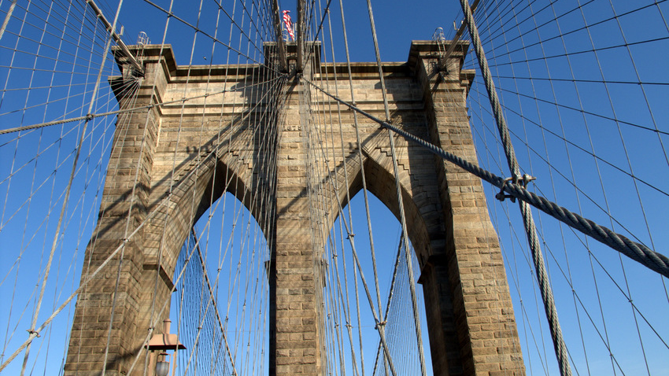
Elliptic Curve Cryptography

Slide 15
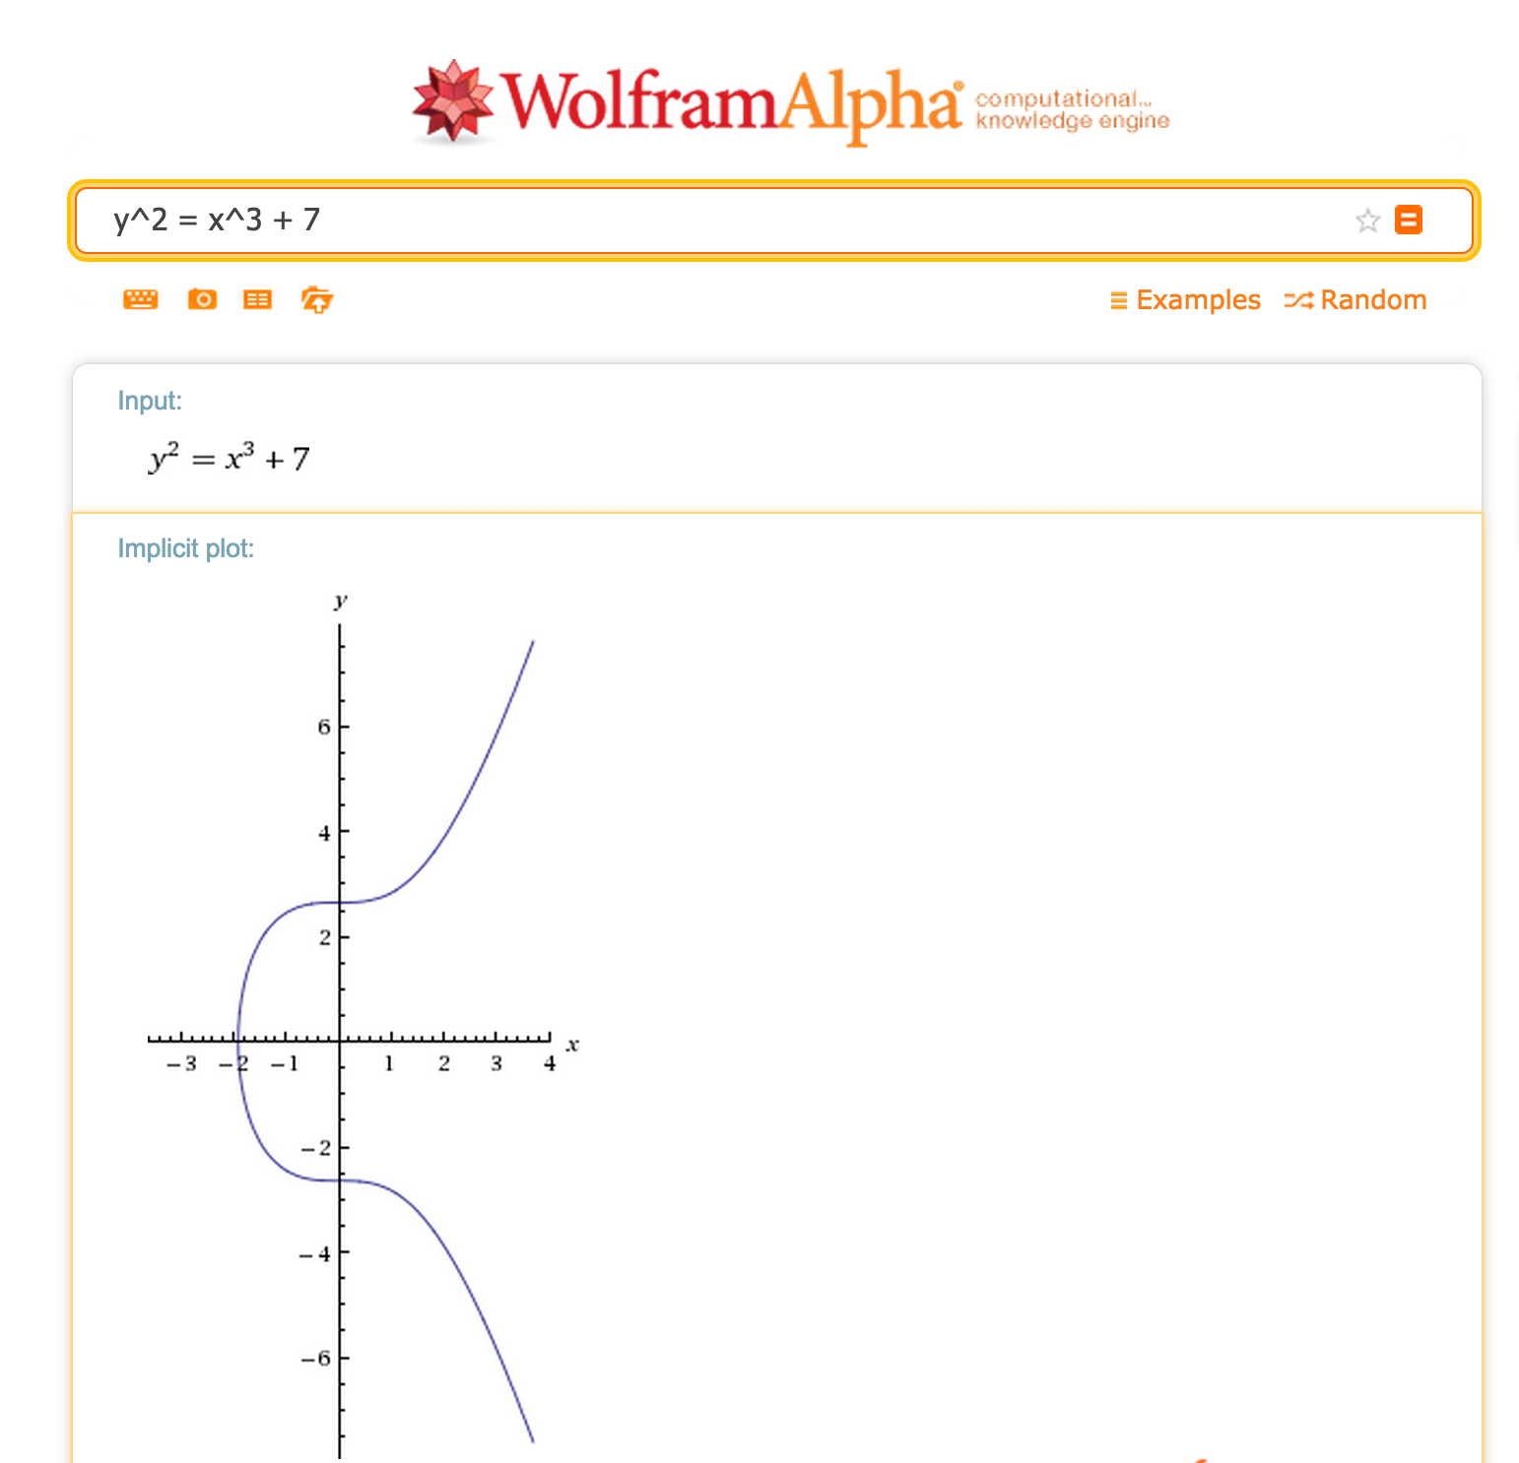
Real numbers are useless!

Slide 16
Groups
A group is a set, G, on which the operation ⊕ is defined with the following properties:
Closure: for all a, b ∈ G, a ⊕ b ∈ G.
Associative: for all a, b, c ∈ G, (a ⊕ b) ⊕ c = a ⊕ (b ⊕ c).
Identity: there is some element, 0 ∈ G, such that:
for all a ∈ G, a ⊕ 0 = 0 ⊕ a = a.
Inverse: for all a ∈ G, there exists an inverse, -a ∈ G, such that a ⊕ (-a) = 0.

Slide 17
Closure: for all a, b ∈ G, a ⊕ b ∈ G.
Associative: for all a, b, c ∈ G, (a ⊕ b) ⊕ c = a ⊕ (b ⊕ c).
Identity: there is some element, 0 ∈ G, such that:
for all a ∈ G, a ⊕ 0 = 0 ⊕ a = a.
Inverse: for all a ∈ G, there exists an inverse, -a ∈ G, such that a ⊕ (-a) = 0.
Is Integers, + a group?

Slide 18
Closure: for all a, b ∈ G, a ⊕ b ∈ G.
Associative: for all a, b, c ∈ G, (a ⊕ b) ⊕ c = a ⊕ (b ⊕ c).
Identity: there is some element, 0 ∈ G, such that:
for all a ∈ G, a ⊕ 0 = 0 ⊕ a = a.
Inverse: for all a ∈ G, there exists an inverse, -a ∈ G, such that a ⊕ (-a) = 0.
Is Naturals, + a group?

Slide 19
Closure: for all a, b ∈ G, a ⊕ b ∈ G.
Associative: for all a, b, c ∈ G, (a ⊕ b) ⊕ c = a ⊕ (b ⊕ c).
Identity: there is some element, 0 ∈ G, such that:
for all a ∈ G, a ⊕ 0 = 0 ⊕ a = a.
Inverse: for all a ∈ G, there exists an inverse, -a ∈ G, such that a ⊕ (-a) = 0.
Is Rationals, * a group?

Slide 20
Abelian Groups
A group is a set, G, on which the operation ⊕ is defined with the following properties:
Closure: for all a, b ∈ G, a ⊕ b ∈ G.
Associative: for all a, b, c ∈ G, (a ⊕ b) ⊕ c = a ⊕ (b ⊕ c).
Identity: there is some element, 0 ∈ G, such that:
for all a ∈ G, a ⊕ 0 = 0 ⊕ a = a.
Inverse: for all a ∈ G, there exists an inverse, -a ∈ G, such that a ⊕ (-a) = 0.
Commutative: for all a, b ∈ G, a ⊕ b = b ⊕ a.

Slide 21
Closure: for all a, b ∈ G, a ⊕ b ∈ G.
Associative: for all a, b, c ∈ G, (a ⊕ b) ⊕ c = a ⊕ (b ⊕ c).
Identity: there is some element, 0 ∈ G, such that:
for all a ∈ G, a ⊕ 0 = 0 ⊕ a = a.
Inverse: for all a ∈ G, there exists an inverse, -a ∈ G, such that a ⊕ (-a) = 0.
Commutative: for all a, b ∈ G, a ⊕ b = b ⊕ a.
Is Rationals – {0}, * an abelian group?

Slide 22
Finite Fields
A finite field is a set F of N ≥ 2 elements on which the operators ⊕ and × are defined with these properties:
The set F is an abelian group with identity 0 under the ⊕ operation.
The set F - { 0 } is an abelian group with identity 1 under the × operation.
Distributive: For all a, b, c ∈ F,
(a ⊕ b) × c = (a × c) ⊕ (b × c).

Slide 23
Know any finite fields?
A finite field is a set F of N ≥ 2 elements on which the operators ⊕ and × are defined with these properties:
The set F is an abelian group with identity 0 under the ⊕ operation.
The set F - { 0 } is an abelian group with identity 1 under the × operation.
Distributive: For all a, b, c ∈ F, (a ⊕ b) × c = (a × c) ⊕ (b × c).

Slide 24
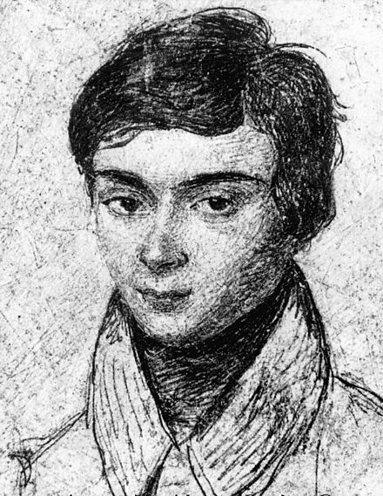
0
6
1
5
2
GF(7)
4
3
Évariste Galois
Killed in duel at 20

Slide 25
Prime Fields
Prime Field Theorem: For every prime number p, the set { 0, 1, …, p - 1 } forms a finite field with the operations addition and multiplication modulo p.

Slide 26
Elliptic Curves in Finite Fields
y² = x³ + 7 in GF(3)

Slide 27
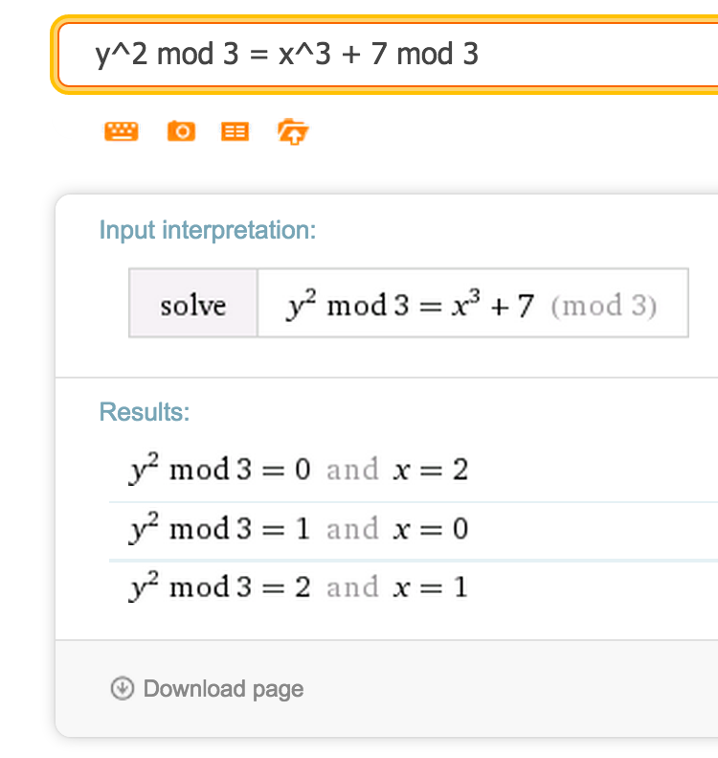
Elliptic Curves in Finite Fields
y² = x³ + 7 in GF(3)

Slide 28
Elliptic Curves in Finite Fields
y² = x³ + 7 in GF(2²⁵⁶ - 2³² - 2⁹ - 2⁸ - 2⁷ - 2⁶ - 2⁴ - 1)

Slide 29
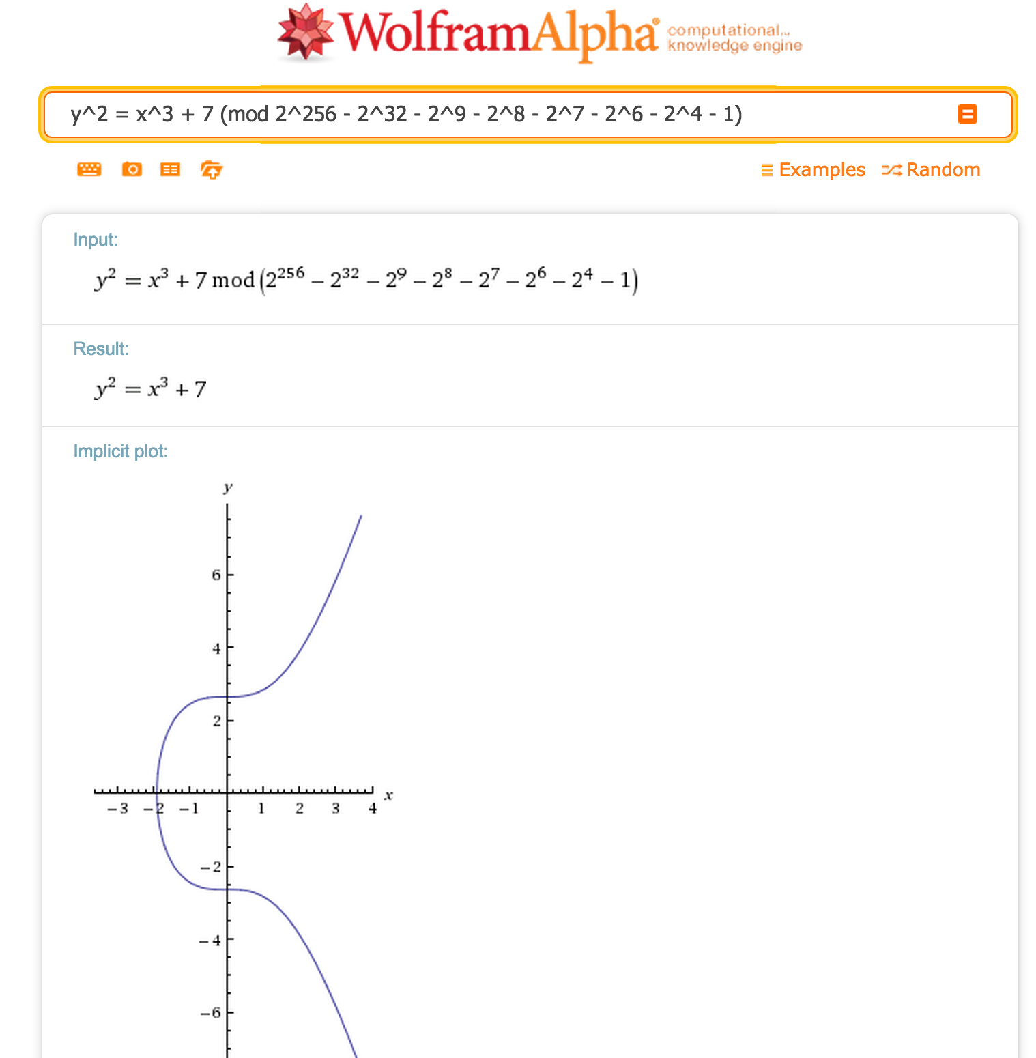
y² = x³ + 7 in GF(2²⁵⁶ - 2³² - 2⁹ - 2⁸ - 2⁷ - 2⁶ - 2⁴ - 1)
115 quattuorvigintillion 792 trevigintillion 89 duovigintillion 237 unvigintillion 316 vigintillion 195 novemdecillion 423 octodecillion 570 septendecillion 985 sexdecillion 8 quindecillion 687 quattuordecillion 907 tredecillion 853 duodecillion 269 undecillion 984 decillion 665 nonillion 640 octillion 564 septillion 39 sextillion 457 quintillion 584 quadrillion 7 trillion 908 billion 834 million 671 thousand 663
(0.0012 × the number of atoms in the visible universe)

Slide 30
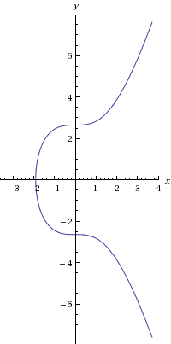
Addition on Elliptic Curves
P + Q
y² = x³ – 7 (mod p)
P
Q
Addition: P + Q
= negate intersection of curve with line through P and Q

Slide 31
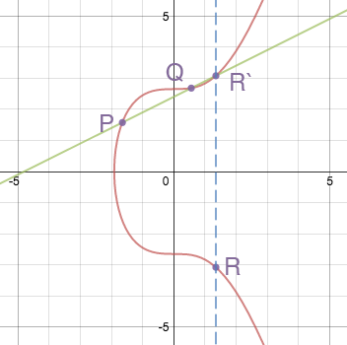
Addition
P + Q = R
What should we do if P = Q?
Image from: http://www.coindesk.com/math-behind-bitcoin/

Slide 32
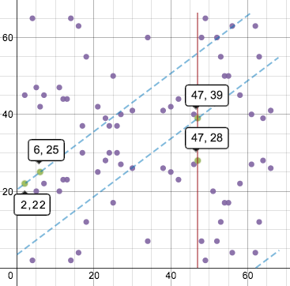
Addition
Same idea for finite fields (just more complex)
Picture is for F₆₇.
How would this look for F_{huge}?
Image from: http://www.coindesk.com/math-behind-bitcoin/

Slide 33
Density of Elliptic Curve
y² = x³ + 7 in GF(2²⁵⁶ - 2³² - 2⁹ - 2⁸ - 2⁷ - 2⁶ - 2⁴ - 1)

Slide 34
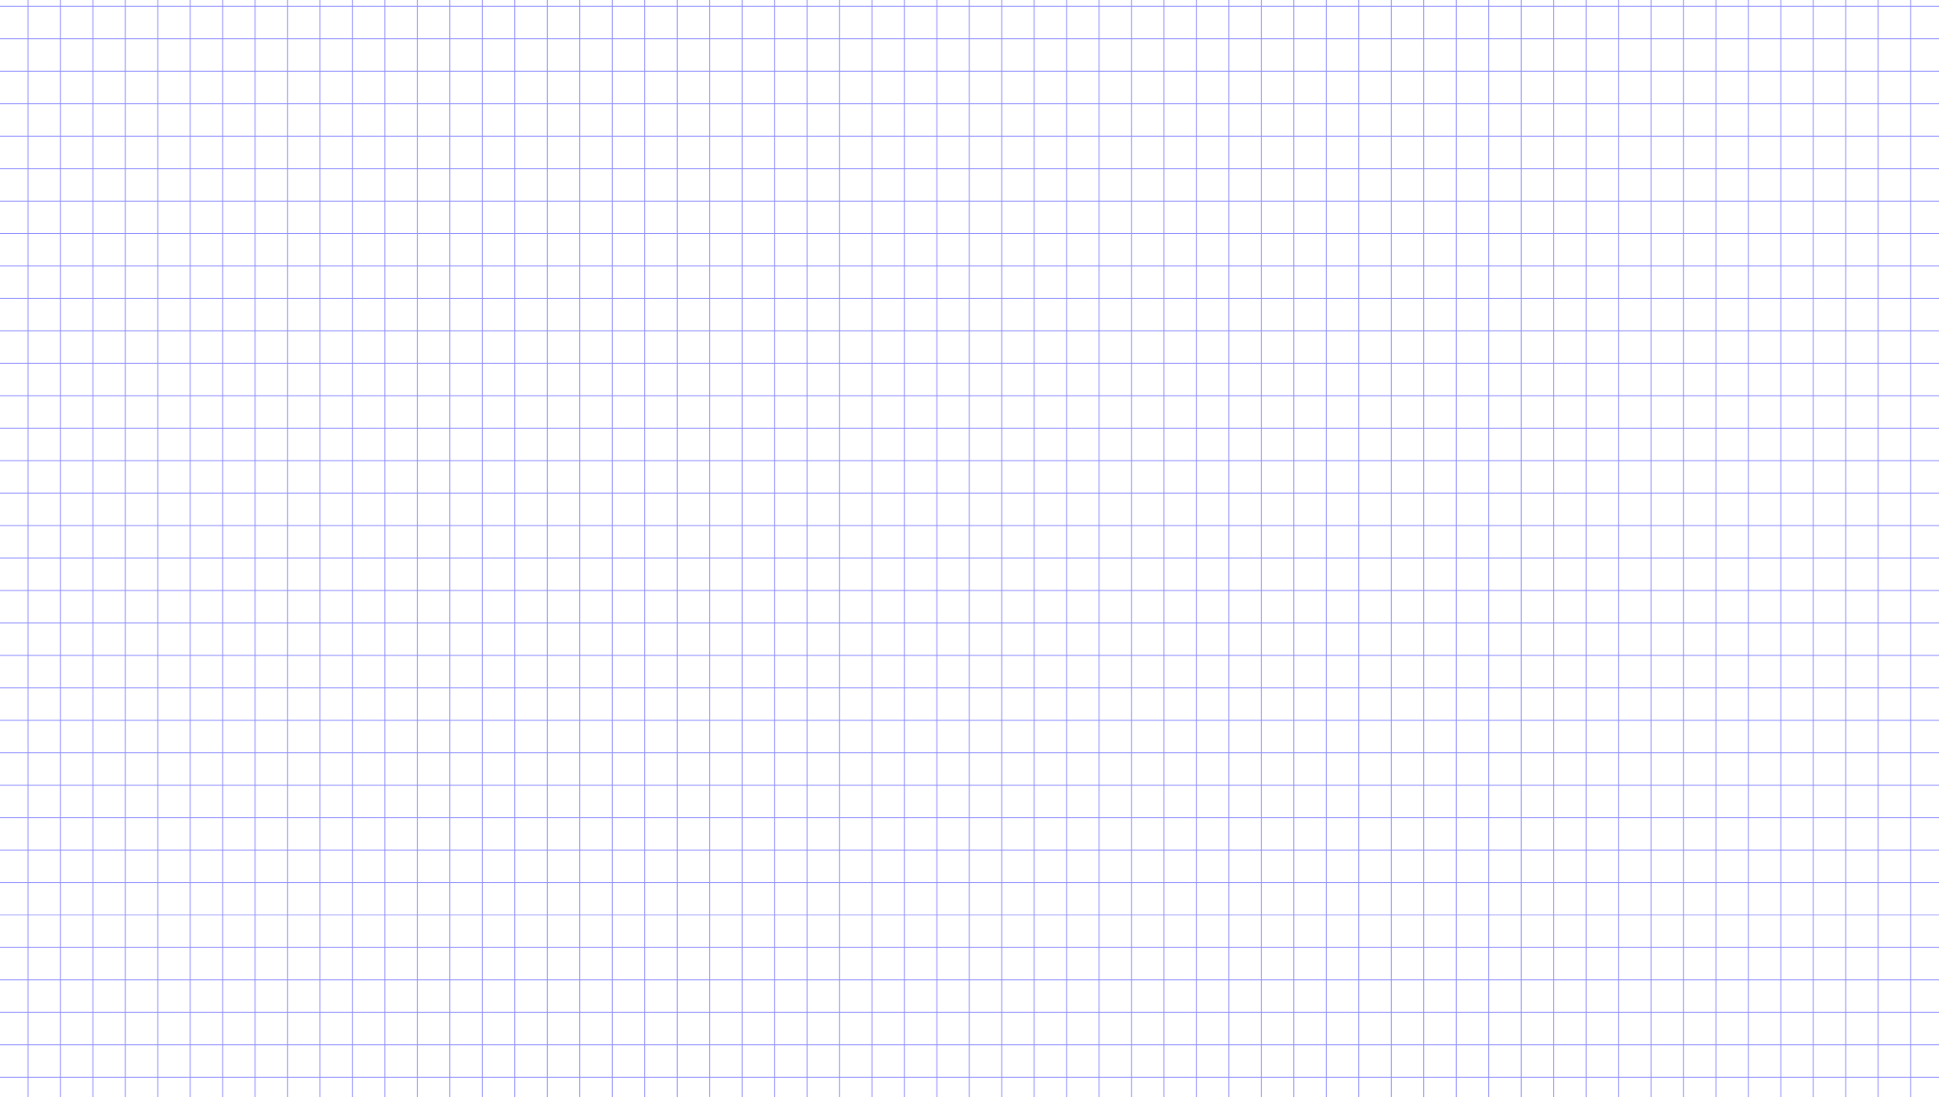

Slide 35
(Believed to be) Hard Problem
Elliptic curve discrete logarithm problem: given points P and Q on an elliptic curve, it is hard to find an integer k such that Q = kP.

Slide 36
Charge
Investigate the bitcoin you received
Project 1 will be posted before midnight tonight and due on Jan 30
Readings: Satoshi’s original bitcoin paper, Chapter 5
Next class: how to use Elliptic Curve Crypto for signatures;
how (not) to use Elliptic Curves for pseudorandom number generation
Next week: preventing double spending

